Slide 1
Manufacturing Analytics
Project Name : Manufacturing Analytics
Group 2

Slide 2
Introduction
This project focuses on analyzing the end-to-end manufacturing performance of the organization. The dashboard highlights the total manufactured quantity, processed quantity and rejected quantity across different machines, departments and employees. It enables management to understand where rejection is occurring, how production is trending and which areas require performance improvement. By visualizing rejection ratio, production comparison and department-wise contribution, the dashboard supports decision making to reduce wastage and improve overall manufacturing efficiency.
Domain: Manufacturing
Business Problem: High rejected quantity and lack of visibility into production performance across machines, departments and processes.
Goal: To analyze manufactured, processed and rejected quantity in order to identify inefficiencies, compare performance and improve overall manufacturing output.

Slide 3
Data Overview
The dataset contains production-level transactional records with fields including manufactured quantity, processed quantity, rejected quantity, department, machine, operation and employee name, etc. These fields help to calculate operational performance metrics such as wastage %, machine-wise rejection and employee-wise contribution. Aggregations were performed to compute total manufacturing output , total rejected quantity and processed quantity which form the basis for KPI calculation and trend analysis.
Files: Manufacturing data.xlsx
Size: 38 Columns and 10561 Rows.
Key Columns: Department Name, Document Date, Employee Code, Employee Name, Item Code, Item Name, Machine Code, Machine Name, Manufactured Quantity, Processed Quantity, Rejected Quantity, Balance Quantity, Fiscal Date, Fiscal Time, Form Type
Aggregations Used: Total Manufactured Quantity, Total Processed Quantity, Total Rejected Quantity, ,Department-wise Rejection %, Machine-wise Rejection Sum, Employee-wise Rejected Items, Production Trend

Slide 4
Objective/KPI
Objective: The objective of this dashboard is to monitor the overall manufacturing output and rejection, identify the machines and departments responsible for higher rejection, and analyze monthly production trends for better decision making. It also aims to evaluate employee-level contribution in rejection and ultimately minimize waste while improving overall operational efficiency
KPI Used:
Total Manufactured Quantity
Total Processed Quantity
Total Rejected Quantity
Wastage %
Manufactured VS Rejected
Department-wise Manufactured VS Rejected
Employee-wise Rejection
Production Comparison Trend
Machine Wise Rejected Quantity

Slide 5
Process
Data Collection : Collected production-related data including manufactured, processed, and rejected quantity along with machine, department, operation, and employee details.
Data Cleaning & Preprocessing :
Checked for missing or duplicate values.
Corrected inconsistent entries (e.g., machine names, work center modes).
Formatted date-time columns for trend analysis.
Data Aggregation: Aggregated metrics like total manufactured, processed, and rejected quantity,
Computed department-wise, machine-wise, and employee-wise summaries.
Dashboard Development :
Excel Dashboard: Quick KPI table and pivot charts .
Tableau Dashboard: Trend analysis and comparative visualizations
Power BI Dashboard: Interactive charts with slicers for department, machine, and operation

Slide 6
Insight Generation:
Analysed production vs rejection.
Identified high rejection machines and departments.
Monitored employee-wise rejected quantity and trends.
Decision Support:
Recommended process improvements based on dashboard insights.
Highlighted areas for reducing rejection and improving efficiency.

Slide 7
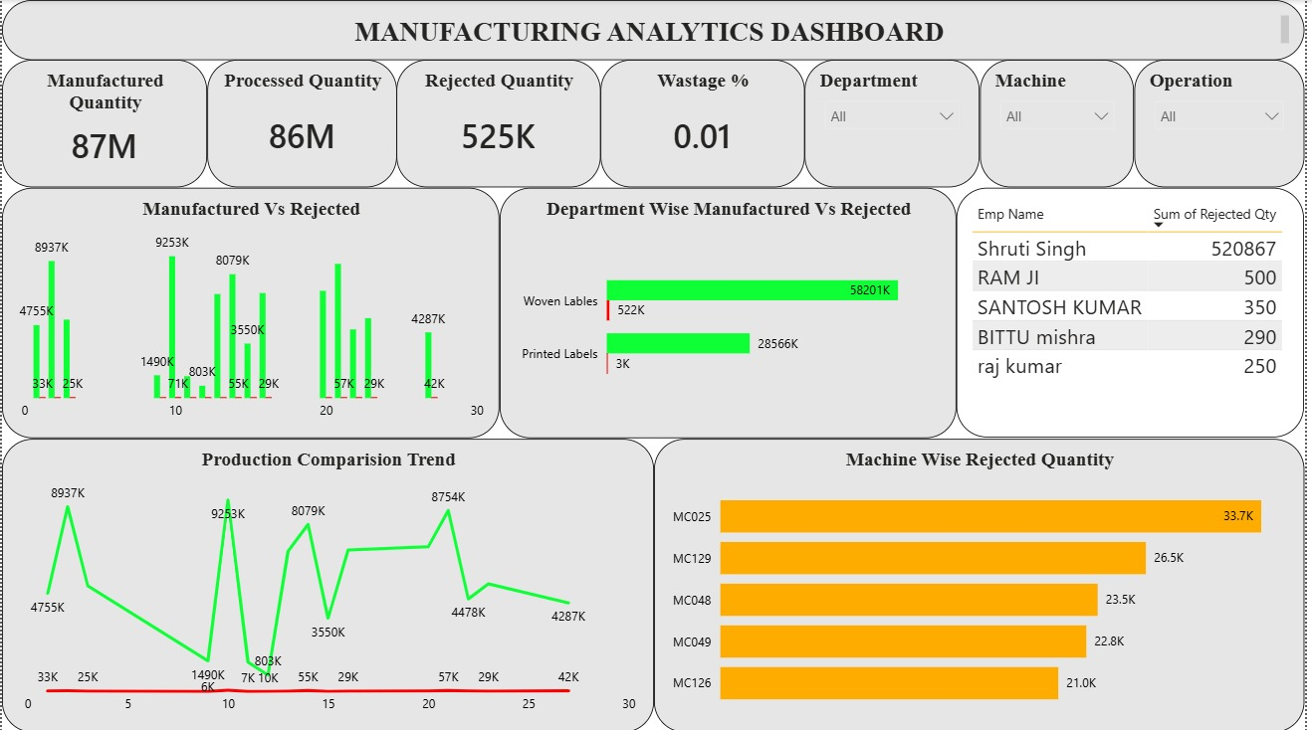
Analysis
KPI Titles
Insights
Total rejection compared to produced is very low
Processed Quantity output is close to manufacturing Quantity.
Wastage % indicates good quality control
Manufactured VS Rejected
Insights
Overall manufactured quantity is much higher compared to rejected quantity
Rejection remains consistently low across production batches.

Slide 8
Department-wise Manufactured vs Rejected
Insights :
Woven labels department contributes most production as well as rejection
Printed labels show lower output but also lower rejection
Employee-wise Rejection
Insights :
Rejection concentrated mainly on a single employee
Large gap between first and other employees indicates skill/process variation
Indicates need for employee-specific training or process monitoring

Slide 9
Production Comparision Trend
Insights :
Trend shows high variation across period.
No stable pattern visible.
Machine-Wise Rejected Quantity
Insights:
Machine MC025 shows maximum rejection.
Consistent rejection across 4 machines,
Improvement required in machine maintenance & setup

Slide 10
Slicers:
Insights:
Slicers allow filtering the dashboard by department, machine and operation
Help identify which department or machine causes more rejection
Make analysis more focused instead of overall numbers
Useful for drill-down investigation and root-cause analysis

Slide 11
Insights and Recommendations
Insights:
Overall manufacturing output is strong (87M units)
Rejection quantity is low but concentrated in specific machines
One employee entry shows disproportionate rejection.
Department performance varies, highest in Woven Labels
Monthly production fluctuates significantly
Machines MC025 and MC129 contribute major rejection
Recommendations :
Provide preventive maintenance on Machine MC029 & MC125
Verify employee rejection entry.
Standardize process quality checks across departments
Automation in inspection can reduce manual rejection
Regular skill training for workforce

Slide 12
Conclusion
This dashboard provides a comprehensive view of manufacturing performance by tracking production, process quantity, and rejection across machines, departments, and employees. The analysis indicates stable overall output with minimal rejection, however specific machines and certain user entries require detailed review. By focusing on machine-wise performance and employee training, the organization can further minimize wastage, maximize productivity and achieve higher operational efficiency.

Slide 13
Challenges and Learnings
Challenges : The Challenges we faced in :
Data cleaning and data type mismatch
Understanding production domain terms
Handling multiple tables and KPIs
Fixing manual entry inconsistencies
Machine codes interpretation
Learnings :
Understanding manufacturing KPIs & operational flow
Creating data models and measures
Building drill-down charts (employee, machine, department)
Comparing rejection vs production visually
Real industry-based insight generation

Slide 14
Dashboard Picture

Slide 15
Thank You

